Slide 1



Noida Institute of Engineering and Technology, Greater Noida
Algebraic Structures
Unit: 2
Discrete Structures & Theory of Logic (KCS-303)
Mr. Gaurav Singhanai
Asst. Prof., IT Dept.
Mr. Bhupendra Kr.
Asst. Prof., IT Dept.
B Tech 3rd Sem

Slide 2
Course Objective
A course discrete structures used to represent discrete objects and relationships between these objects. These discrete structures include sets, relation , permutations, relations, graphs and trees etc.
The subject enhances one’s ability to develop logical thinking and ability to problem solving.

Slide 3
Unit 2 Objective(CO2)
This course aims to provide a first approach to the subject of algebra, which is one of the basic pillars of modern mathematics. The focus of the course will be the study of certain structures called groups, rings, fields and some related structures.
Abstract algebra gives to student a good mathematical maturity and enables to build mathematical thinking and skill
By the end of the module students should be familiar with the topics listed above under `Contents'. In particular, they should be able to prove different Theorems, and to use them and other techniques as a tool for analyzing the structure of a finite group of a given order.

Slide 4
Course Outcome
Course Outcome ( CO) | At the end of course , the student will be able to understand | Bloom’s Knowledge Level (KL)
CO1 | Write an argument using logical notation and determine if the argument is or is not valid. | K3, K4
CO2 | Understand the basic principles of sets and operations in sets. | K1, K2
CO3 | Demonstrate an understanding of relations and functions and be able to determine their properties | K3
CO4 | Demonstrate different traversal methods for trees and graphs. | K1, K4
CO5 | Model problems in Computer Science using graphs and trees. | K2, K6

Slide 5
CO-PO’s and PSO’s Mapping
 | PO1 | PO2 | PO3 | PO4 | PO5 | PO6 | PO7 | PO8 | PO9 | PO10 | PO11 | PO12
KCS303.1 | 3 | 2 | 2 | - | - | 1 | - | - | - | 1 | 1 | 3
KCS303.2 | 3 | 3 | 2 | 2 | 1 | - | - | - | - | - | 2 | 1
KCS303.3 | 3 | 3 | 2 | 1 | - | - | 3 | - | 2 | 2 | 2 | 2
KCS303.4 | 3 | 3 | 2 | 1 | - | - | 1 | - | - | 3 | 2 | 2
KCS303.5 | 3 | 3 | 2 | 1 | - | - | 3 | - | - | 1 | 3 | 3
 | PSO1 | PSO2 | PSO3 | PSO4
KCS303.1 | 1 | 2 | 3 | -
KCS303.2 | 1 | 2 | 3 | 1
KCS303.3 | 3 | 2 | 3 | 1
KCS303.4 | 2 | 3 | 3 | -
KCS303.5 | 2 | 3 | 2
5

Slide 6
Unit 2 Prerequisite & Recap
Prerequisite
Basic Understanding of class 10 mathematics NCERT.
Basic Knowledge of sets and algebraic rules
Basic Understanding of Set Theory, Relations and Functions .
Recap
Now students are able to develop there logical thinking by using Sets, Relations, Functions and Mathematical Induction concepts and use in upcoming topic. i.e. Algebraic Structures

Slide 7
Content (CO2)
Algebraic Structures:
Definition
Groups
Subgroups and order
Cyclic Groups
Cosets
Lagrange's theorem
Normal Subgroups
Group Homomorphisms
Definition and elementary properties of Rings and Fields

Slide 8
Topic Objective: Algebraic Structures (CO2)
This course aims to provide a first approach to the subject of algebra, which is one of the basic pillars of modern mathematics. The focus of the course will be the study of certain structures called groups, rings, fields and some related structures.
Algebraic Structures also known as Abstract algebra gives a good mathematical maturity and enables to build mathematical thinking and skill to students.
By the end of the module students should be familiar with the topics listed above under `Contents'. In particular, they should be able to prove different Theorems, and to use them and other techniques as a tool for analyzing the structure of a finite group of a given order.

Slide 9
Topic Prerequisite & Recap (CO2)
Prerequisite
Basic Understanding of class 10 mathematics NCERT.
Basic Knowledge of sets and algebraic rules
Basic Understanding of Set Theory, Relations and Functions .
Recap
Now students are able to develop there logical thinking by using Sets, Relations, Functions and Mathematical Induction concepts and use in upcoming topic. i.e. Algebraic Structures

Slide 10
Algebraic Structures (CO2)
N = {1,2,3,4,…..∝ } = Set of all natural numbers.
Z = { 0, ± 1, ± 2, ± 3, ± 4 , ….. ∝} = Set of all integers.
Q = Set of all rational numbers.
R = Set of all real numbers.
Binary Operation: The binary operator * is said to be a binary operation (closed operation) on a non empty set A, if
a * b ∈ A for all a, b ∈ A (Closure property).
Ex: The set N is closed with respect to addition and multiplication
but not w.r.t subtraction and division.
Algebraic System: A set ‘A’ with one or more binary(closed) operations defined on it is called an algebraic system.
Ex: (N, + ), (Z, +, – ), (R, +, . , – ) are algebraic systems.

Slide 11
Properties (CO2)
Commutative: Let * be a binary operation on a set A. The operation * is said to be commutative in A if a * b= b * a for all a, b in A
Associativity: Let * be a binary operation on a set A. The operation * is said to be associative in A if (a * b) * c = a *( b * c) for all a, b, c in A
Identity: For an algebraic system (A, *), an element ‘e’ in A is said to be an identity element of A if a * e = e * a = a for all a ∈ A.
Note: For an algebraic system (A, *), the identity element, if exists, is unique.
Inverse: Let (A, *) be an algebraic system with identity ‘e’. Let a be an element in A. An element b is said to be inverse of A if
a * b = b * a = e

Slide 12
Semi group (CO2)
Semi Group: An algebraic system (A, *) is said to be a semi group if
1. * is closed operation on A.
2. * is an associative operation, for all a, b, c in A.
Ex. (N, +) is a semi group.
Ex. (N, .) is a semi group.
Ex. (N, – ) is not a semi group.
Monoid: An algebraic system (A, *) is said to be a monoid if the following conditions are satisfied.
1) * is a closed operation in A.
2) * is an associative operation in A.
3) There is an identity in A.

Slide 13
Monoid (CO2)
Ex. Show that the set ‘N’ is a monoid with respect to multiplication.
Solution: Here, N = {1,2,3,4,……}
1. Closure property : We know that product of two natural numbers is again a natural number.
i.e., a.b = b.a for all a,b ∈ N
∴ Multiplication is a closed operation.
2. Associativity : Multiplication of natural numbers is associative.
i.e., (a.b).c = a.(b.c) for all a,b,c ∈ N
3. Identity : We have, 1 ∈ N such that
a.1 = 1.a = a for all a ∈ N.
∴ Identity element exists, and 1 is the identity element.
Hence, N is a monoid with respect to multiplication.

Slide 14
Subsemigroup & submonoid (CO2)
Subsemigroup : Let (S, * ) be a semigroup and let T be a subset of S. If T is closed under operation * , then (T, * ) is called a subsemigroup of (S, * ).
Ex: (N, .) is semigroup and T is set of multiples of positive integer m then (T,.) is a sub semigroup.
Submonoid : Let (S, * ) be a monoid with identity e, and let T be a non- empty subset of S. If T is closed under the operation * and e ∈ T, then (T, * ) is called a submonoid of (S, * ).

Slide 15
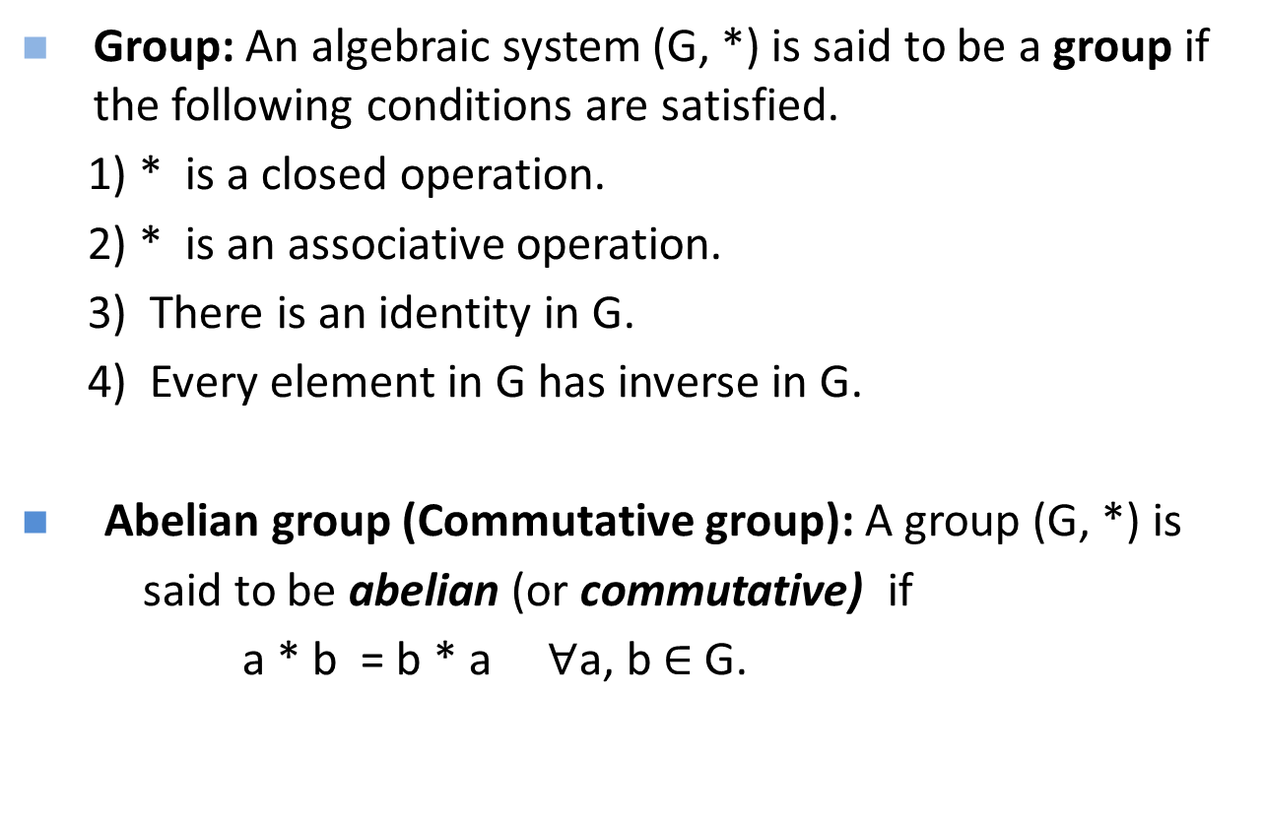
Group (CO2)
Group: An algebraic system (G, *) is said to be a group if the following conditions are satisfied.
1) * is a closed operation.
2) * is an associative operation.
3) There is an identity in G.
4) Every element in G has inverse in G.
Abelian group (Commutative group): A group (G, *) is
said to be abelian (or commutative) if
a * b = b * a $∀$a, b $∈$ G.

Slide 16
Algebraic systems (CO2)
Algebraic Structure. A non-empty set G equipped with one or more binary operations is said to be an algebraic structure. Suppose * is a binary operation on G. Then (G, *) is an algebraic structure.
Abelian groups
Groups
Monoids
Semi groups
Algebraic systems

Slide 17
Theorem (CO2)
In a Group (G, * ) the following properties hold good
1. Identity element is unique.
2. Inverse of an element is unique.
3. Cancellation laws hold good
a * b = a * c ⇒ b = c (left cancellation law)
a * c = b * c ⇒ a = b (Right cancellation law)
4. (a * b) ⁻¹ = b⁻¹ * a⁻¹
In a group, the identity element is its own inverse.
Order of a group : The number of elements in a group is called order of the group.
Finite group: If the order of a group G is finite, then G is called a finite group.

Slide 18
Ex. Show that, the set of all integers is a group with respect to addition (CO2).
Solution: Let Z = set of all integers.
Let a, b, c are any three elements of Z.
1. Closure property : We know that, Sum of two integers is again an integer.
i.e., a + b ∈ Z for all a,b ∈ Z
2. Associativity: We know that addition of integers is associative.
i.e., (a+b)+c = a+(b+c) for all a,b,c ∈ Z.
3. Identity : We have 0 ∈ Z and a + 0 = a for all a ∈ Z .
∴ Identity element exists, and ‘0’ is the identity element.
4. Inverse: To each a ∈ Z , we have – a ∈ Z such that
a + ( – a ) = 0
Each element in Z has an inverse.
5. Commutativity: We know that addition of integers is commutative.
i.e., a + b = b +a for all a,b ∈ Z.
Hence, ( Z , + ) is an abelian group.

Slide 19
Ex. Show that set of all non zero real numbers is a group with respect to multiplication (CO2).
Solution: Let R* = set of all non zero real numbers.
Let a, b, c are any three elements of R* .
1. Closure property : We know that, product of two nonzero real numbers is again a nonzero real number . i.e., a . b ∈ R* for all a,b ∈ R* .
2. Associativity: We know that multiplication of real numbers is
associative. i.e., (a.b).c = a.(b.c) for all a,b,c ∈ R* .
3. Identity : We have 1 ∈ R* and a .1 = a for all a ∈ R* .
∴ Identity element exists, and ‘1’ is the identity element.
4. Inverse: To each a ∈ R* , we have 1/a ∈ R* such that
a .(1/a) = 1 i.e., Each element in R* has an inverse.
5.Commutativity: We know that multiplication of real numbers is
commutative. i.e., a . b = b . a for all a,b ∈ R*.
Hence, ( R* , . ) is an abelian group.

Slide 20
Example (CO2)
Example: Show that set of all real numbers ‘R’ is not a group with respect to multiplication.
Solution: We have 0 ∈ R .
The multiplicative inverse of 0 does not exist.
Hence. R is not a group.

Slide 21
Example (CO2)
Ex. Let (Z, *) be an algebraic structure, where Z is the set of integers
and the operation * is defined by n * m = maximum of (n, m).
Show that (Z, *) is a semi group.
Is (Z, *) a monoid ?. Justify your answer.
Solution: Let a , b and c are any three integers.
Closure property: Now, a * b = maximum of (a, b) ∈ Z for all a,b ∈ Z
Associativity : (a * b) * c = maximum of {a,b,c} = a * (b * c)
∴ (Z, *) is a semi group.
Identity : There is no integer x such that
a * x = maximum of (a, x) = a for all a ∈ Z
∴ Identity element does not exist. Hence, (Z, *) is not a monoid.

Slide 22
Example (CO2)
Ex. Show that the set of all strings ‘S’ is a monoid under the operation ‘concatenation of strings’.
Is S a group w.r.t the above operation? Justify your answer.
Solution: Let us denote the operation ‘concatenation of strings’ by + .
Let s₁, s₂, s₃ are three arbitrary strings in S.
Closure property: Concatenation of two strings is again a string.
i.e., s₁+s₂ ∈ S
Associativity: Concatenation of strings is associative.
(s₁+ s₂ ) + s₃ = s₁+ (s₂ + s₃ )
Identity: We have null string , λ ∈ S such that s₁ + λ = S.
∴ S is a monoid.
Note: S is not a group, because the inverse of a non empty string does not exist under concatenation of strings.

Slide 23
Ex. If M is set of all non singular matrices of order ‘n x n’. then show that M is a group w.r.t. matrix multiplication. Is (M, *) an abelian group?. Justify your answer (CO2).
Solution: Let A,B,C ∈ M.
1. Closure property : Product of two non singular matrices is again a non singular matrix, because⏐AB⏐ = ⏐A⏐ . ⏐B⏐ ≠ 0 ( Since, A and B are nonsingular) i.e., AB ∈ M for all A,B ∈ M .
2. Associativity: Marix multiplication is associative. i.e., (AB)C = A(BC) for all A,B,C ∈ M .
3. Identity : We have I_{n} ∈ M and A I_{n} = A for all A ∈ M .
∴ Identity element exists, and ‘I_{n}’ is the identity element.
4. Inverse: To each A ∈ M, we have A⁻¹ ∈ M such that A A⁻¹ = I_{n} i.e., Each element in M has an inverse.
∴ M is a group w.r.t. matrix multiplication.
We know that, matrix multiplication is not commutative.
Hence, M is not an abelian group.

Slide 24
Example (CO2)
Ex. Show that the set of all positive rational numbers forms an abelian group under the composition * defined by a * b = (ab)/2.
Solution: Let A = set of all positive rational numbers.
Let a,b,c be any three elements of A.
1. Closure property: We know that, Product of two positive rational numbers is again a rational number.
i.e., a *b ∈ A for all a,b ∈ A .
2. Associativity: (a*b)*c = (ab/2) * c = (abc) / 4
a*(b*c) = a * (bc/2) = (abc) / 4
3. Identity : Let e be the identity element.
We have a*e = (a e)/2 …(1) , By the definition of *
again, a*e = a …..(2) , Since e is the identity.
From (1)and (2), (a e)/2 = a ⇒ e = 2 and 2 ∈ A .
Identity element exists, and ‘2’ is the identity element in A.

Slide 25
Continue... (CO2)
4. Inverse: Let a ∈ A
let us suppose b is inverse of a.
Now, a * b = (a b)/2 ….(1) (By definition of inverse.)
Again, a * b = e = 2 …..(2) (By definition of inverse)
From (1) and (2), it follows that
(a b)/2 = 2
⇒ b = (4 / a) ∈ A
∴ (A ,*) is a group.
Commutativity: a * b = (ab/2) = (ba/2) = b * a
Hence, (A,*) is an abelian group.

Slide 26
Theorem (CO2)
Ex. In a group (G, *) , Prove that the identity element is unique.
Proof :
a) Let e₁ and e₂ are two identity elements in G.
Now, e₁ * e₂ = e₁ …(1) (since e₂ is the identity)
Again, e₁ * e₂ = e₂ …(2) (since e₁ is the identity)
From (1) and (2), we have e₁ = e₂
∴ Identity element in a group is unique.

Slide 27
Theorem (CO2)
Ex. In a group (G, *) , Prove that the inverse of any element is unique.
Proof:
Let a ,b,c ∈G and e is the identity in G.
Let us suppose, Both b and c are inverse elements of a .
Now, a * b = e …(1) (Since, b is inverse of a )
Again, a * c = e …(2) (Since, c is also inverse of a )
From (1) and (2), we have
a * b = a * c
⇒ b = c (By left cancellation law)
In a group, the inverse of any element is unique.

Slide 28
Theorem (CO2)
Ex. In a group (G, *) , Prove that (a * b)⁻¹ = b⁻¹ * a⁻¹ for all a,b ∈G.
Proof :
Consider,
(a * b) * ( b⁻¹ * a⁻¹)
= (a * ( b * b⁻¹ ) * a⁻¹) (By associative property).
= (a * e * a⁻¹) ( By inverse property)
= ( a * a⁻¹) ( Since, e is identity)
= e ( By inverse property)
Similarly, we can show that
(b⁻¹ * a⁻¹) * (a * b) = e
Hence, (a * b)⁻¹ = b⁻¹ * a⁻¹ .

Slide 29
Theorem (CO2)
Ex. If (G, *) is a group and a ∈ G such that a * a = a , then show that a = e , where e is identity element in G.
Proof: Given that, a * a = a
⇒ a * a = a * e ( Since, e is identity in G)
⇒ a = e ( By left cancellation law)
Hence, the result follows.

Slide 30
Ex. If every element of a group is its own inverse, then show that the group must be abelian .
Theorem (CO2)
Proof: Let (G, *) be a group.
Let a and b are any two elements of G.
Consider the identity,
(a * b)⁻¹ = b⁻¹ * a⁻¹
⇒ (a * b ) = b * a ( Since each element of G is its own
inverse)
Hence, G is abelian.

Slide 31
Note: a² = a * a a³ = a * a * a etc.
Theorem (CO2)
Ex. In a group (G, *), if (a * b)² = a² * b² ∀a,b ∈ G
then show that G is abelian group.
Proof: Given that (a * b)² = a² * b²
⇒ (a * b) * (a * b) = (a * a )* (b * b)
⇒ a *( b * a )* b = a * (a * b) * b ( By associative law)
⇒ ( b * a )* b = (a * b) * b ( By left cancellation law)
⇒ ( b * a ) = (a * b) ( By right cancellation law)
Hence, G is abelian group.

Slide 32
Finite groups (CO2)
Ex. Show that G = {1, -1} is an abelian group under multiplication.
Solution: The composition table of G is
. 1 – 1
1 1 – 1
– 1 – 1 1
1. Closure property: Since all the entries of the composition table are the elements of the given set, the set G is closed under multiplication.
2. Associativity: The elements of G are real numbers, and we know that multiplication of real numbers is associative.
3. Identity : Here, 1 is the identity element and 1∈ G.
4. Inverse: From the composition table, we see that the inverse elements of
1 and – 1 are 1 and – 1 respectively. Hence, G is a group w.r.t multiplication.
5. Commutativity: The corresponding rows and columns of the table are identical. Therefore the binary operation . is commutative.
Hence, G is an abelian group w.r.t. multiplication.

Slide 33
Ex. Show that G = {1, ω, ω²} is an abelian group under multiplication. Where 1, ω, ω² are cube roots of unity. (CO2)
Solution: The composition table of G is
. 1 ω ω²
1 1 ω ω²
ω ω ω² 1
ω² ω² 1 ω
1. Closure property: Since all the entries of the composition table are the elements of the given set, the set G is closed under multiplication.
2. Associativity: The elements of G are complex numbers, and we know that multiplication of complex numbers is associative.
3. Identity : Here, 1 is the identity element and 1∈ G.
4. Inverse: From the composition table, we see that the inverse elements of
1 ω, ω² are 1, ω², ω respectively. Hence, G is a group w.r.t multiplication.
5. Commutativity: The corresponding rows and columns of the table are identical. Therefore the binary operation . is commutative.
Hence, G is an abelian group w.r.t. multiplication.

Slide 34
Ex. Show that G = {1, –1, i, –i } is an abelian group under multiplication. (CO2)
Solution: The composition table of G is . 1 –1 i -i
1 1 -1 i - i
-1 -1 1 -i i
i i -i -1 1
-i -i i 1 -1
1. Closure property: Since all the entries of the composition table are the elements of the given set, the set G is closed under multiplication.
2. Associativity: The elements of G are complex numbers, and we know that multiplication of complex numbers is associative.
3. Identity : Here, 1 is the identity element and 1∈ G.
4. Inverse: From the composition table, we see that the inverse elements of
1 -1, i, -i are 1, -1, -i, i respectively.
5. Commutativity: The corresponding rows and columns of the table are identical. Therefore the binary operation . is commutative. Hence, (G, .) is an abelian group.

Slide 35
Modulo systems (CO2)
Addition modulo m ( +_{m} )
let m is a positive integer. For any two positive integers a and b
a +_{m} b = a + b if a + b < m
a +_{m} b = r if a + b ≥ m where r is the remainder obtained
by dividing (a+b) with m.
Multiplication modulo p ( ×_{p} )
let p is a positive integer. For any two positive integers a and b
a ×_{p} b = a b if a b < p
a ×_{p} b = r if a b ≥ p where r is the remainder obtained
by dividing (ab) with p.
Ex. 3 ×₅ 4 = 2 , 5 ×₅ 4 = 0 , 2 ×₅ 2 = 4

Slide 36
Ex. The set G = {0,1,2,3,4,5} is a group with respect to addition modulo 6.
Example - Addition Modulo (+_{m} ) (CO2)
Solution: The composition table of G is
+₆ 0 1 2 3 4 5
0 0 1 2 3 4 5
1 1 2 3 4 5 0
2 2 3 4 5 0 1
3 3 4 5 0 1 2
4 4 5 0 1 2 3
5 5 0 1 2 3 4
1. Closure property: Since all the entries of the composition table are the elements of the given set, the set G is closed under +₆ .

Slide 37
Continue… (CO2)
2. Associativity: The binary operation +₆ is associative in G.
for ex. (2 +₆ 3) +₆ 4 = 5 +₆ 4 = 3 and
2 +₆ ( 3 +₆ 4 ) = 2 +₆ 1 = 3
3. Identity : Here, The first row of the table coincides with the top row. The element heading that row , i.e., 0 is the identity element.
4. . Inverse: From the composition table, we see that the inverse elements of 0, 1, 2, 3, 4. 5 are 0, 5, 4, 3, 2, 1 respectively.
5. Commutativity: The corresponding rows and columns of the table are identical. Therefore the binary operation +₆ is commutative.
Hence, (G, +₆ ) is an abelian group.

Slide 38
Ex. The set G = {1,2,3,4,5,6} is a group with respect to multiplication modulo 7.
Example - Multiplication Modulo (×_{m} ) (CO2)
Solution: The composition table of G is
×₇ 1 2 3 4 5 6
1 1 2 3 4 5 6
2 2 4 6 1 3 5
3 3 6 2 5 1 4
4 4 1 5 2 6 3
5 5 3 1 6 4 2
6 6 5 4 3 2 1
1. Closure property: Since all the entries of the composition table are the elements of the given set, the set G is closed under ×₇ .

Slide 39
Continue… (CO2)
2. Associativity: The binary operation ×₇ is associative in G.
for ex. (2 ×₇ 3) ×₇ 4 = 6 ×₇ 4 = 3 and
2 ×₇ ( 3 ×₇ 4 ) = 2 ×₇ 5 = 3
3. Identity : Here, The first row of the table coincides with the top row. The element heading that row , i.e., 1 is the identity element.
4. Inverse: From the composition table, we see that the inverse elements of 1, 2, 3, 4. 5 ,6 are 1, 4, 5, 2, 5, 6 respectively.
5. Commutativity: The corresponding rows and columns of the table are identical. Therefore the binary operation ×₇ is commutative.
Hence, (G, ×₇ ) is an abelian group.

Slide 40
Important Points (CO2)
In a group with 2 elements, each element is its own inverse
In a group of even order there will be at least one element (other than identity element) which is its own inverse
The set G = {0,1,2,3,4,…..m-1} is a group with respect to addition modulo m.
The set G = {1,2,3,4,….p-1} is a group with respect to multiplication modulo p, where p is a prime number.
Order of an element of a group:
Let (G, *) be a group. Let ‘a’ be an element of G. The smallest integer n such that a^{n} = e is called order of ‘a’. If no such number exists then the order is infinite.

Slide 41
Sub groups (CO2)
Def. A non empty sub set H of a group (G, *) is a sub group of G,
if (H, *) is a group.
Note: For any group {G, *}, {e, * } and (G, * ) are trivial sub groups.
Ex. G = {1, -1, i, -i } is a group w.r.t multiplication.
H₁ = { 1, -1 } is a subgroup of G .
H₂ = { 1 } is a trivial subgroup of G.
Ex. ( Z , + ) and (Q , + ) are sub groups of the group (R +).
Theorem: A non empty sub set H of a group (G, *) is a sub group of G iff
i) a * b ∈ H ∀ a, b ∈ H
ii) a⁻¹ ∈ H ∀ a ∈ H

Slide 42
Normal Subgroups (CO2)
Let
be a subgroup of
. Then
is a normal subgroup if, for any
, the left
coset
is equal to the right coset
is a normal subgroup where
e.g.
Theorem: In an Abelian group, every subgroup is a normal subgroup.

Slide 43
Theorem (CO2)
Theorem: A necessary and sufficient condition for a non empty subset H of a group (G, *) to be a sub group is that
a ∈ H, b ∈ H ⇒ a * b⁻¹ ∈ H.
Proof:
Case1: Let (G, *) be a group and H is a subgroup of G
Let a,b ∈ H ⇒ b⁻¹ ∈ H ( since H is is a group)
⇒ a * b⁻¹ ∈ H. ( By closure property in H)
Case2: Let H be a non empty set of a group (G, *).
Let a * b⁻¹ ∈ H ∀ a, b ∈ H
Now, a * a⁻¹ ∈ H ( Taking b = a )
⇒ e ∈ H i.e., identity exists in H.
Now, e ∈ H, a ∈ H ⇒ e * a⁻¹ ∈ H
⇒ a⁻¹ ∈ H

Slide 44
Continue… (CO2)
∴ Each element of H has inverse in H.
Further, a ∈ H, b ∈ H ⇒ a ∈ H, b⁻¹ ∈ H
⇒ a * (b⁻¹)⁻¹ ∈ H.
⇒ a * b ∈ H.
∴ H is closed w.r.t * .
Finally, Let a,b,c ∈ H
⇒ a,b,c ∈ G ( since H ⊆ G )
⇒ (a * b) * c = a * (b * c)
∴ * is associative in H
Hence, H is a subgroup of G.

Slide 45
Ex. Show that the intersection of two sub groups of a group G is again a sub group of G.
Example (CO2)
Proof: Let (G, *) be a group.
Let H₁ and H₂ are two sub groups of G.
Let a , b ∈ H₁ ∩ H₂ .
Now, a , b ∈ H₁ ⇒ a * b⁻¹ ∈ H₁ ( Since, H₁ is a subgroup of G)
again, a , b ∈ H₂ ⇒ a * b⁻¹ ∈ H₂ ( Since, H₂ is a subgroup of G)
∴ a * b⁻¹ ∈ H₁ ∩ H₂ .
Hence, H₁ ∩ H₂ is a subgroup of G .

Slide 46
Ex. Show that the union of two sub groups of a group G need not be a sub group of G.
Example (CO2)
Proof: Let G be an additive group of integers.
Let H₁ = { 0, ±2, ±4, ±6, ±8, …..}
and H₂ = { 0, ±3, ±6, ±9, ±12, …..}
Here, H₁ and H₂ are groups w.r.t addition.
Further, H₁ and H₂ are subsets of G.
∴ H₁ and H₂ are sub groups of G.
H₁ ∪ H₂ = { 0, ±2, ±3, ±4, ±6, …..}
Here, H₁ ∪ H₂ is not closed w.r.t addition.
For ex. 2 , 3 ∈ G
But, 2 + 3 = 5 and 5 does not belongs to H₁ ∪ H₂ .
Hence, H₁ ∪ H₂ is not a sub group of G.

Slide 47
Homomorphism and Isomorphism (CO2).
Homomorphism : Consider the groups ( G, *) and ( G¹, ⊕)
A function f : G → G¹ is called a homomorphism if
f ( a * b) = f(a) ⊕ f (b)
Isomorphism : If a homomorphism f : G → G¹ is a bijection then f is called isomorphism between G and G¹ .
Then we write G ≡ G¹

Slide 48
Example (CO2)
Ex. Let R be a group of all real numbers under addition and R⁺ be a group of all positive real numbers under multiplication. Show that the mapping f : R → R⁺ defined by f(x) = 2^{x} for all x ∈ R is an isomorphism.
Solution: First, let us show that f is a homomorphism.
Let a , b ∈ R .
Now, f(a+b) = 2^{a+b}
= 2ª 2^{b}
= f(a).f(b)
∴ f is an homomorphism.
Next, let us prove that f is a Bijection.

Slide 49
Continue… (CO2)
For any a , b ∈ R, Let, f(a) = f(b)
⇒ 2ª = 2^{b}
⇒ a = b
∴ f is one.to-one.
Next, take any c ∈ R⁺.
Then log₂ c ∈ R and f (log₂ c ) = 2 ^{log2 c} = c.
⇒ Every element in R⁺ has a pre image in R.
i.e., f is onto.
∴ f is a bijection.
Hence, f is an isomorphism.

Slide 50
Example (CO2)
Ex. Let R be a group of all real numbers under addition and R⁺ be a group of all positive real numbers under multiplication. Show that the mapping f : R⁺ → R defined by f(x) = log₁₀ x for all x ∈ R is an isomorphism.
Solution: First, let us show that f is a homomorphism.
Let a , b ∈ R⁺ .
Now, f(a.b) = log₁₀ (a.b)
= log₁₀ a + log₁₀ b
= f(a) + f(b)
∴ f is an homomorphism.
Next, let us prove that f is a Bijection.

Slide 51
Continue… (CO2)
For any a , b ∈ R⁺ , Let, f(a) = f(b)
⇒ log₁₀ a = log₁₀ b
⇒ a = b
∴ f is one.to-one.
Next, take any c ∈ R.
Then 10^{c} ∈ R and f (10^{c}) = log₁₀ 10^{c} = c.
⇒ Every element in R has a pre image in R⁺ .
i.e., f is onto.
∴ f is a bijection.
Hence, f is an isomorphism.

Slide 52
Theorem (CO2)
Theorem: Consider the groups ( G₁, *) and ( G₂, ⊕) with identity elements e₁ and e₂ respectively. If f : G₁ → G₂ is a group homomorphism, then prove that
a) f(e₁) = e₂
b) f(a⁻¹) = [f(a)]⁻¹
c) If H₁ is a sub group of G₁ and H₂ = f(H₁),
then H₂ is a sub group of G₂.
d) If f is an isomorphism from G₁ onto G₂,
then f ^{–1} is an isomorphism from G₂ onto G_{1.}

Slide 53
Proof (CO2)
a) we have in G₂,
e₂ ⊕ f(e₁) = f (e₁) ( since, e₂ is identity in G₂)
= f (e_{1 *} e₁) ( since, e₁ is identity in G₁)
= f(e₁) ⊕ f(e₁) ( since f is a homomorphism)
e₂ = f(e₁) ( By right cancellation law )
b) For any a ∈ G₁, we have
f(a) ⊕ f(a⁻¹) = f (a * a⁻¹) = f(e₁) = e₂
and f(a⁻¹) ⊕ f(a) = f (a⁻¹ * a) = f(e₁) = e₂
∴ f(a⁻¹) is the inverse of f(a) in G₂
i.e., [f(a)]⁻¹ = f(a⁻¹)

Slide 54
Continue… (CO2)
c) H₂ = f (H₁) is the image of H₁ under f; this is a subset of G₂.
Let x , y ∈ H₂.
Then x = f(a) , y = f(b) for some a,b ∈H₁
Since, H₁is a subgroup of G₁, we have a * b⁻¹ ∈ H₁.
Consequently,
x ⊕ y⁻¹ = f(a) ⊕ [f(b)]⁻¹
= f(a) ⊕ f(b⁻¹)
= f (a * b⁻¹) ∈f(H₁) = H₂
Hence, H₂ is a subgroup of G₂.

Slide 55
Continue… (CO2)
d) Since f : G₁ → G₂ is an isomorphism, f is a bijection.
∴ f ^{–1} : G₂ → G₁ exists and is a bijection.
Let x, y ∈ G_{2.} Then x ⊕ y ∈ G₂
and there exists a, b ∈ G₁ such that x = f(a) and y = f(b).
∴ f ^{–1} (x ⊕ y ) = f ^{–1} (f(a) ⊕ f(b) )
= f ^{–1} (f (a* b ) )
= a * b
= f ^{–1} (x) * f ^{–1} (y)
This shows that f ^{–1} : G₂ → G₁ is an homomorphism as well.
∴ f ^{–1} is an isomorphism.

Slide 56
Cosets (CO2)
If H is a sub group of( G, * ) and a ∈ G then the set
Ha = { h * a⎮ h ∈ H}is called a right coset of H in G.
Similarly aH = {a * h ⎢ h ∈ H}is called a left coset of H is G.
Note:- 1) Any two left (right) cosets of H in G are either identical or disjoint.
2) Let H be a sub group of G. Then the right cosets of H form a
partition of G. i.e., the union of all right cosets of a sub group H is equal to G.
3) Lagrange’s theorem: The order of each sub group of a finite group is a divisor of the order of the group.
4) The order of every element of a finite group is a divisor of the order of the group.
5) The converse of the lagrange’s theorem need not be true.

Slide 57
Example (CO2)
Ex. If G is a group of order p, where p is a prime number. Then the number of sub groups of G is
a) 1 b) 2 c) p – 1 d) p
Ans. b
Ex. Prove that every sub group of an abelian group is abelian.
Solution: Let (G, * ) be a group and H is a sub group of G.
Let a , b ∈ H
⇒ a , b ∈ G ( Since H is a subgroup of G)
⇒ a * b = b * a ( Since G is an abelian group)
Hence, H is also abelian.

Slide 58
Topic Prerequisite & Recap (CO2)
Prerequisite
Basic Understanding of class 10 mathematics NCERT.
Basic Knowledge of sets and algebraic rules
Basic Understanding of Set Theory, Relations and Functions .
Basic Understanding of Algebraic Structures & Coset.
Recap
Now students are able to develop there logical thinking by using Sets, Relations, Functions and Mathematical Induction, Algebraic Structures & Coset concepts and use in upcoming topic. i.e. Lagrange’s Theorem

Slide 59
State and prove Lagrange’s Theorem (CO2)
Lagrange’s theorem: The order of each sub group H of a finite group G is a divisor of the order of the group.
Proof: Since G is finite group, H is finite.
Therefore, the number of cosets of H in G is finite.
Let Ha₁,Ha₂, …,Ha_{r} be the distinct right cosets of H in G.
Then, G = Ha₁∪Ha₂∪ …, ∪Ha_{r}
So that O(G) = O(Ha₁)+O(Ha₂) …+ O(Ha_{r}).
But, O(Ha₁) = O(Ha₂) = ….. = O(Ha_{r}) = O(H)
∴ O(G) = O(H)+O(H) …+ O(H). (r terms)
= r . O(H)
This shows that O(H) divides O(G).

Slide 60
Ring (CO2)
Let <R, +, .> be an algebraic structure for a nonempty set R and two binary operations + and . defined on it.
1) The operation + is commutative and associative.
a + b = b + a, for all a, b ∈ R.
a + (b + c) = (a + b) + c, for all a, b, c ∈ R.
2) There exists the identity element 0 in R w.r.t. +.
a + 0 = 0 + a = a, for every a ∈ R.
3) Every element in R is invertible w.r.t. +.
With every a ∈ R there exists in R its inverse element,
denoted by (–a).
a + (–a) = (–a) + a = 0.

Slide 61
Ring (CO2)
4) The operation . is associative.
a . ( b. c) = (a . b) . c for all a, b, c ∈ R.
5) The operation . is distributive over the operation + in
R.
a . (b + c) = (a . b) + (a . c)
(a + b) . c = (a . c) + (b . c) for all a, b, c ∈ R.

Slide 62
Zero element of the ring (CO2)
Identity element w.r.t. + the operation + (0).
Negative of a
Inverse (–a) w.r.t. + of a ∈ R.
Examples
1. <Z, +, x>, Z is a set of integers and binary operations + and x.
2. <Q, +, x>, Q is a set of rational nos. and binary operations + and x.
3. <R, +, x>, R is a set of real nos. and binary operations + and x.
4. <C, +, x>, C is a set of complex nos. and binary operations + and x.

Slide 63
Commutative Ring (CO2)
If the operations +, . are commutative in a ring <R, +, .>.
Examples
1. <Z, +, x>, Z is a set of integers and binary operations + and x.
2. <Q, +, x>, Q is a set of rational nos. and binary operations + and x.
3. <R, +, x>, R is a set of real nos. and binary operations + and x.
4. <C, +, x>, C is a set of complex nos. and binary operations + and x.

Slide 64
Ring with Unity (CO2)
If the operations +, . have identity elements in a ring <R, +, .>.
Examples
1. <Z, +, x>, Z is a set of integers and binary operations + and x.
2. <Q, +, x>, Q is a set of rational nos. and binary operations + and x.
3. <R, +, x>, R is a set of real nos. and binary operations + and x.
4. <C, +, x>, C is a set of complex nos. and binary operations + and x.

Slide 65
Integral Domain (CO2)
a . b = 0 ⇒ a = 0 or b = 0 for a commutative ring with unity <R, +, .>.
Examples
1. <Z, +, x>, Z is a set of integers and binary operations + and x.
2. <Q, +, x>, Q is a set of rational nos. and binary operations + and x.
3. <R, +, x>, R is a set of real nos. and binary operations + and x.
4. <C, +, x>, C is a set of complex nos. and binary operations + and x.

Slide 66
Field (CO2)
If a ring <R, +, .>
is commutative
has the unity
every nonzero element of R has the inverse under the . operation.
Commutative ring with unity in which every nonzero element has a multiplicative inverse.
Examples
1. <Q, +, x>, Q is a set of rational nos. and binary operations + and x.
2. <R, +, x>, R is a set of real nos. and binary operations + and x.
3. <C, +, x>, C is a set of complex nos. and binary operations + and x.
4. <Z, +, x>, Z is a set of integers and binary operations + and x is not a field as Z does not contain multiplicative inverses of all its nonzero elements.

Slide 67
Exercises (CO2)
1) Let S = {0, 1} and the operations + and . on s be defined by the following tables:
Show that <S, +, .> is a commutative ring with unity.
+ | 0 | 1
0 | 0 | 1
1 | 1 | 0
. | 0 | 1
0 | 0 | 0
1 | 0 | 1

Slide 68
Exercises (CO2)
2) Let S = {a, b, c, d} and the operations + and . on s be defined by the following tables:
Show that <S, +, .> is a ring.
+ | a | b | c | d
a | a | b | c | d
b | b | a | d | c
c | c | d | b | a
d | d | c | a | b
. | a | b | c | d
a | a | a | a | a
b | a | a | b | a
c | a | b | c | d
d | a | a | d | a

Slide 69
Faculty Video Links, Youtube & NPTEL Video Links and Online Courses Details (CO2)
Youtube/other Video Links
https://www.youtube.com/watch?v=dQ4wU0k7JKI&list=PL0862D1A947252D20&index=35 CO2
https://www.youtube.com/watch?v=urd468CJCcU&list=PL0862D1A947252D20&index=36 CO2
https://www.youtube.com/watch?v=YB6CP1RUvgk&list=PL0862D1A947252D20&index=37 CO2

Slide 70
Daily Quiz (CO2)
1. This is an abelian group { – 3 n : n ε Z } under? A. division B. subtraction C. addition D. multiplication
2. What is the inverse of – ι If G = { 1, -1, ι, – ι } is group under multiplication? A. −1 B. ι C. 1 D. None of Above
3. The monoid is a? A. a non-abelian group B. groupoid C. A group D. a commutative group

Slide 71
Daily Quiz (CO2)
4. (ba)-1 =_____ If a, b are elements of a group G? A. b-1 a B. a-1 b C. b-1 a-1 D. a-1 b-1
5. What is an inverse of – i in the multiplicative group if {1, – 1, i , – i} is? A. -1 B. 1 C. I D. None of these
6. What is the value of (a- 1 b)- 1 is in the group (G, .)? A. b- 1a B. ab-1 C. ba-1 D. a-1b
7. What is the inverse of an if (Z,*) is a group with a*b = a+b+1 ∀ a, b ∈Z? A. -2 B. 0 C. -a-2 D. a-2

Slide 72
Daily Quiz (CO2)
8. Which sentence is true? A. Set of all matrices forms a group under multiplication B. Set of all rational negative numbers forms a group under multiplication C. Set of all non-singular matrices forms a group under multiplication D. Both (b) and (c)
9. Which statement is false? A. The set of rational integers is an abelian group under addition B. The set of rational numbers form an abelian group under multiplication C. The set of rational numbers is an abelian group under addition D. None of these
10. What is the identity element In the group G = {2, 4, 6, 8) under multiplication modulo 10? A. 5 B. 9 C. 6 D. 12

Slide 73
Weekly Assignment (CO2)
Let (G, *) be a group, where * is usual multiplication operation on G. Then show that for any x, y ∈G following equations holds: (x⁻¹)⁻¹ = x (xy)⁻¹ = y⁻¹x⁻¹
Define rings and write its properties.
Write the properties of Group. Show that the set(1,2,3,4,5)is not group under addition and multiplication modulo 6.
Define rings and fields
Show that (R – {1}, *) where the operation is defined as a*b = a +b –ab is an abelian group.

Slide 74
Weekly Assignment (CO2)
Let G = (Z², +) be a group and let H be a subgroup of G where H = {(x, y) | x = y}. Find the left cosets of H in G. Here Z is the set of integers
Let u₈ = {1, 3, 5, 7} be a group with binary operation multiplication modulo 8. Find all proper subgroups of u_{8.}
Prove that (R, +, *) is a ring with zero divisors, where R is 2×2 matrix and + and * are usual addition and multiplication operations.

Slide 75
MCQ s (CO2)
1. This is an abelian group { – 3 n : n ε Z } under? A. division B. subtraction C. addition D. multiplication
2. What is the inverse of – ι If G = { 1, -1, ι, – ι } is group under multiplication? A. −1 B. ι C. 1 D. None of Above
3. The monoid is a? A. a non-abelian group B. groupoid C. A group D. a commutative group

Slide 76
MCQ s (CO2)
4. (ba)-1 =_____ If a, b are elements of a group G? A. b-1 a B. a-1 b C. b-1 a-1 D. a-1 b-1
5. What is an inverse of – i in the multiplicative group if {1, – 1, i , – i} is? A. -1 B. 1 C. I D. None of these
6. What is the value of (a- 1 b)- 1 is in the group (G, .)? A. b- 1a B. ab-1 C. ba-1 D. a-1b
7. What is the inverse of an if (Z,*) is a group with a*b = a+b+1 ∀ a, b ∈Z? A. -2 B. 0 C. -a-2 D. a-2

Slide 77
MCQ s (CO2)
8. Which sentence is true? A. Set of all matrices forms a group under multiplication B. Set of all rational negative numbers forms a group under multiplication C. Set of all non-singular matrices forms a group under multiplication D. Both (b) and (c)
9. Which statement is false? A. The set of rational integers is an abelian group under addition B. The set of rational numbers form an abelian group under multiplication C. The set of rational numbers is an abelian group under addition D. None of these
10. What is the identity element In the group G = {2, 4, 6, 8) under multiplication modulo 10? A. 5 B. 9 C. 6 D. 12

Slide 78
Old Question Papers (CO2)
Write the properties of Group. Show that the set(1,2,3,4,5)is not group under addition and multiplication modulo 6.
Define rings and fields
Show that (R – {1}, *) where the operation is defined as a*b = a +b –ab is an abelian group.
Let G = (Z², +) be a group and let H be a subgroup of G where H = {(x, y) | x = y}. Find the left cosets of H in G. Here Z is the set of integers
Prove that (R, +, *) is a ring with zero divisors, where R is 2×2 matrix and + and * are usual addition and multiplication operations.
Write the properties of Group. Show that the set(1,2,3,4,5)is not group under addition and multiplication modulo 6.

Slide 79
Old Question Papers (CO2)
Define rings and fields
Show that (R – {1}, *) where the operation is defined as a*b = a +b –ab is an abelian group.
Let G = (Z², +) be a group and let H be a subgroup of G where H = {(x, y) | x = y}. Find the left cosets of H in G. Here Z is the set of integers.
Let (G, *) be a group, where * is usual multiplication operation on G. Then show that for any x, y ∈G following equations holds:
(x⁻¹)⁻¹ = x
(xy)⁻¹ = y⁻¹x⁻¹
Define rings and write its properties.
Let u₈ = {1, 3, 5, 7} be a group with binary operation multiplication modulo 8. Find all proper subgroups of u_{8.}

Slide 80
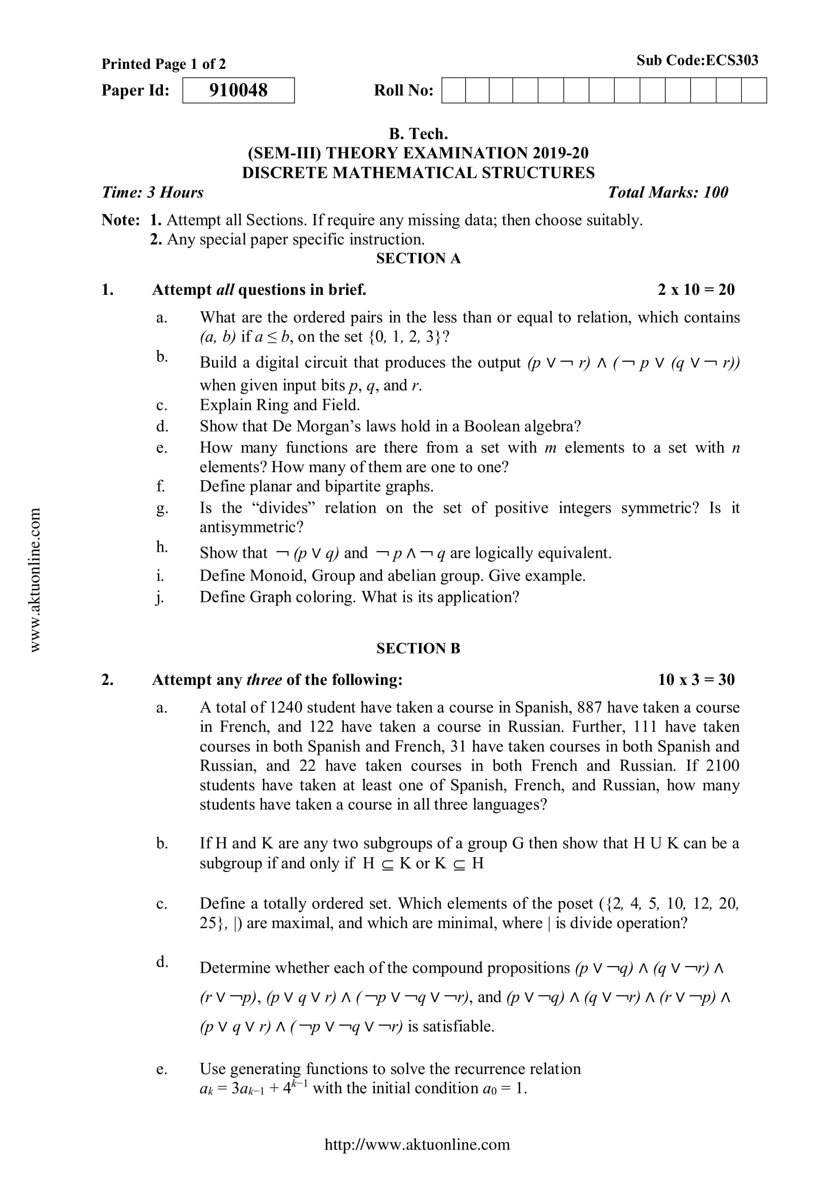
Old Question Papers (CO2)

Slide 81
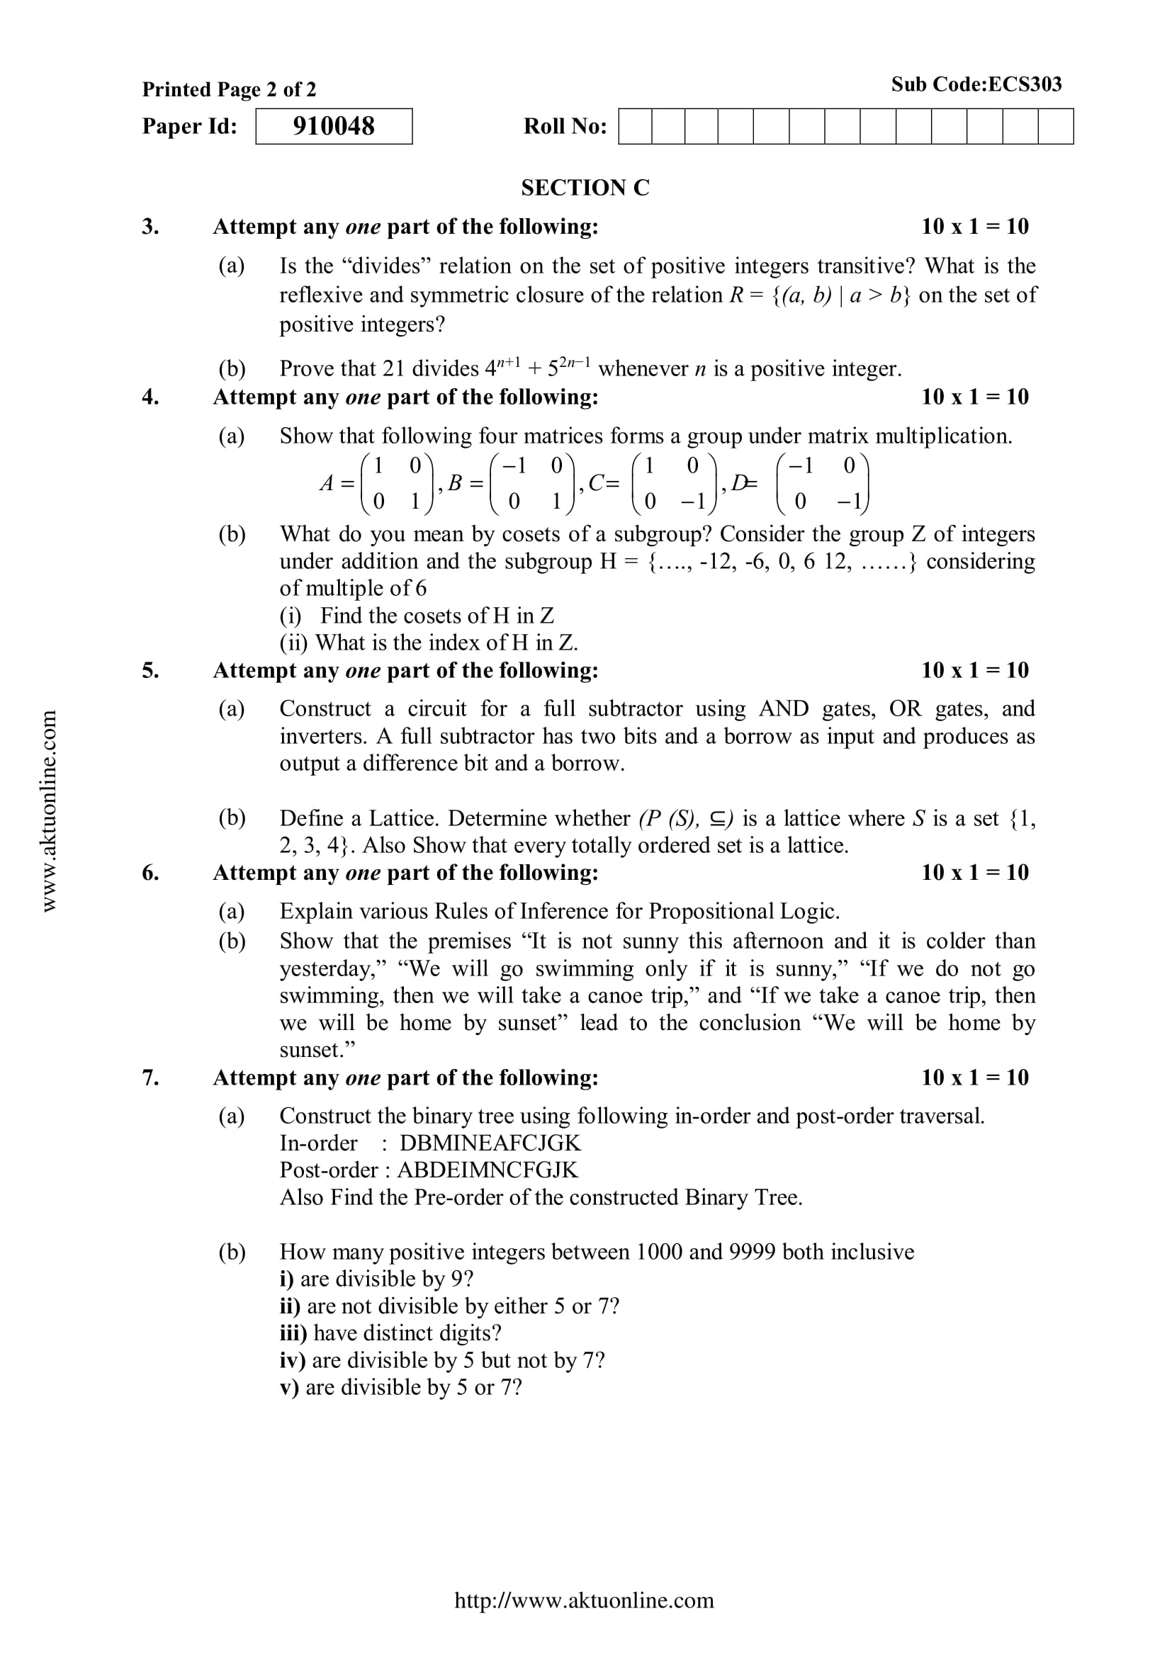
Old Question Papers (CO2)

Slide 82
Old Question Papers (CO2)
For some more Old Question Papers visit the link below.
https://drive.google.com/drive/folders/1LBqJvyWPNRCdAcr9Sag4TzECfnLgRIQn?usp=sharing

Slide 83
Expected Questions for University Exam (CO2)
Define rings and write its properties.
Write the properties of Group. Show that the set(1,2,3,4,5)is not group under addition and multiplication modulo 6.
Define rings and fields
Show that (R – {1}, *) where the operation is defined as a*b = a +b –ab is an abelian group.
Let G = (Z², +) be a group and let H be a subgroup of G where H = {(x, y) | x = y}. Find the left cosets of H in G. Here Z is the set of integers
Let (G, *) be a group, where * is usual multiplication operation on G. Then show that for any x, y ∈G following equations holds:
(x⁻¹)⁻¹ = x
(xy)⁻¹ = y⁻¹x⁻¹

Slide 84
Expected Questions for University Exam (CO2)
Let u₈ = {1, 3, 5, 7} be a group with binary operation multiplication modulo 8. Find all proper subgroups of u_{8.}
Prove that (R, +, *) is a ring with zero divisors, where R is 2×2 matrix and + and * are usual addition and multiplication operations.
Write the properties of Group. Show that the set(1,2,3,4,5)is not group under addition and multiplication modulo 6.
Define rings and fields
Show that (R – {1}, *) where the operation is defined as a*b = a +b –ab is an abelian group.
Let G = (Z², +) be a group and let H be a subgroup of G where H = {(x, y) | x = y}. Find the left cosets of H in G. Here Z is the set of integers.

Slide 85
Summary (CO2)
Algebraic Structure. A non-empty set G equipped with one or more binary operations is said to be an algebraic structure. Suppose * is a binary operation on G. Then (G, *) is an algebraic structure.
The subject enhances one’s ability to develop logical thinking and ability to problem solving.
Abelian groups
Groups
Monoids
Semi groups
Algebraic systems

Slide 86
References
B. Kolman, R.C. Busby, and S.C. Ross, Discrete Mathematical Structures, 5/e, Prentice Hall, 2004.
Liptschutz, Seymour, “ Discrete Mathematics”, McGraw Hill.
Trembley, J.P & R. Manohar, “Discrete Mathematical Structure with Application to Computer Science”, McGraw Hill
Koshy, Discrete Structures, Elsevier Pub. 2008 Kenneth H. Rosen, Discrete Mathematics and Its Applications, 6/e, McGraw-Hill, 2006.

Slide 87
Thank You

